Slide 1

TutorBot
Final
Presentation
Ben Euto, Shahaan Khan, Vaibhav Deokar

Slide 2



Meet
the Team
Ben Euto
Shahaan Khan
Vaibhav Deokar

Slide 3
Project Overview
Refresh
Take in user ChatGPT logs
Clean and identify recurring/common mistakes with writing style
Develop a plan based on the weak areas
Follow through with weekly/bi-weekly check-ins with daily (adjustable) practice
Create a GUI to interface with
Track baseline and improvement metrics

Slide 4
Project Goals: Expected Workflow
User Uploads their ChatGPT Logs
Analyze the Data and Identify Weak Points
Users export their ChatGPT logs
Users upload their ChatGPT logs to Tutorbot
Utilize Antropic API to create classification of errors
Compare to see what gives accurate results
Follow Through with Check-ins
Generate Weakness Report
Based on the results from the clustering
Generate a guide on how to improve with set timelines
Establish a baseline
Create repeating time based check-in
Update the baseline
Actively update learning path

Slide 5
Accomplishments
We’ve created an entire UI for our application
Front-end and back-end constructed
Code can evaluate the entirety of a users ChatGPT logs to get results
Able to generate a report based on punctuation, spelling and grammar criteria
Time taken to evaluate all messages will depend on the number of messages you have
  Can range from ~1-20 minutes
Low Cost
Notes:
💡 In the Industrial Age, machines took over physical labor—yet humans still needed the gym to stay strong. 🧠 In the AI Age, LLMs take over cognitive labor—yet humans still need a mental gym to stay sharp.
So the motivation is driven by curiosity - you would ask thing you are curiousu about

Slide 6
What We’re Evaluating
5
Grammar
Examples of grammar issues include subject-verb disagreement and incorrect pronoun usage
Punctuation
Examples of punctuation issues include any missing commas or inconsistent sentence splices
Tone
Examples of tone issues include sentences that are overly verbose or too casual for a professional context

Slide 7
Our Approach
Heuristic Filtering
LLM Confirmation
Scoring Each Chat
Identifying Recurring Patterns
Step 1
Uses keyword matching to find writing-related messages
Filters out obvious non-writing content (code, math, workouts, games)
Permissive strategy: keeps anything that might be writing-related
Step 2
AI verifies each message from Step 1 is actually writing-related
Returns true/false for each message in batches of 10
Removes false positives that passed keyword filtering
Step 3
AI scores each confirmed message on 3 dimensions (Grammar, Punctuation, Tone)
Provides 1-5 rating and lists specific issues for each message
Processes in batches of 10 messages per API call
Step 4
AI analyzes all evaluations to find recurring patterns
Groups similar issues and ranks by frequency
Returns top 1-5 issues per category with severity ratings

Slide 8
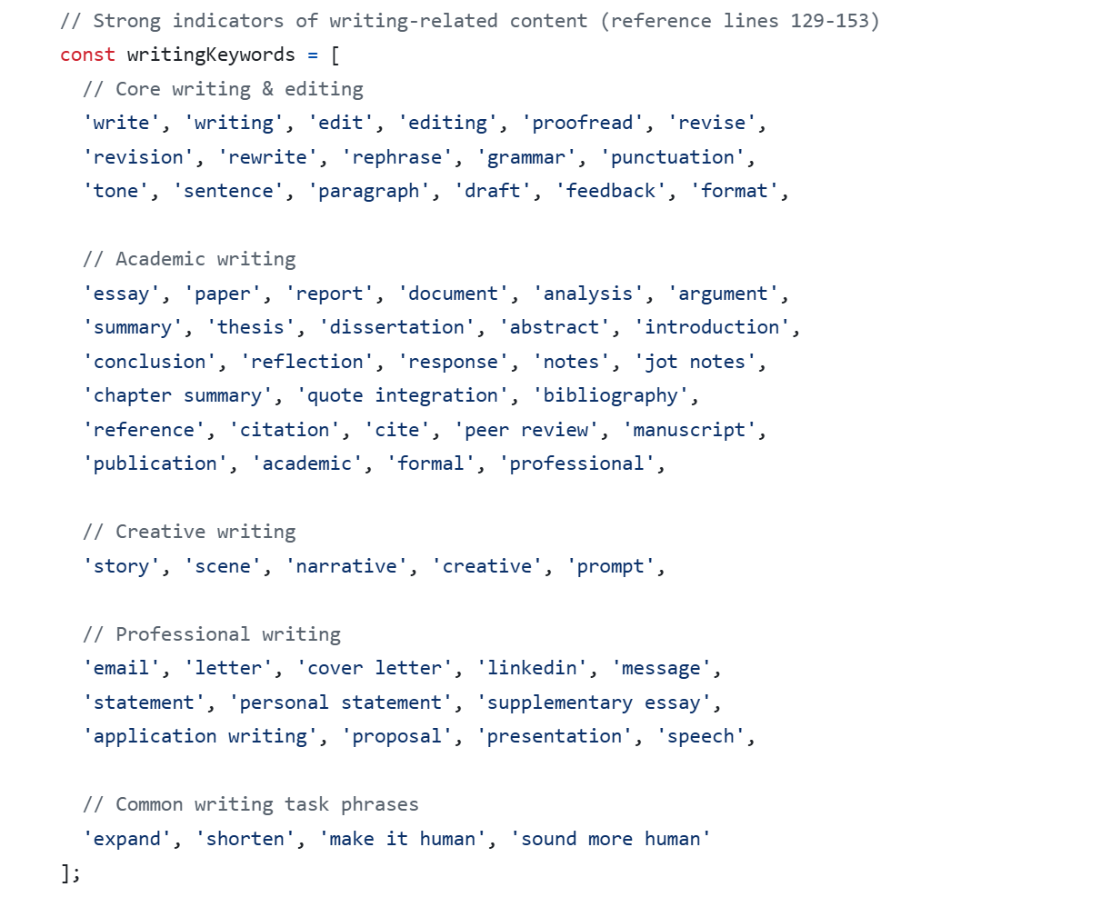
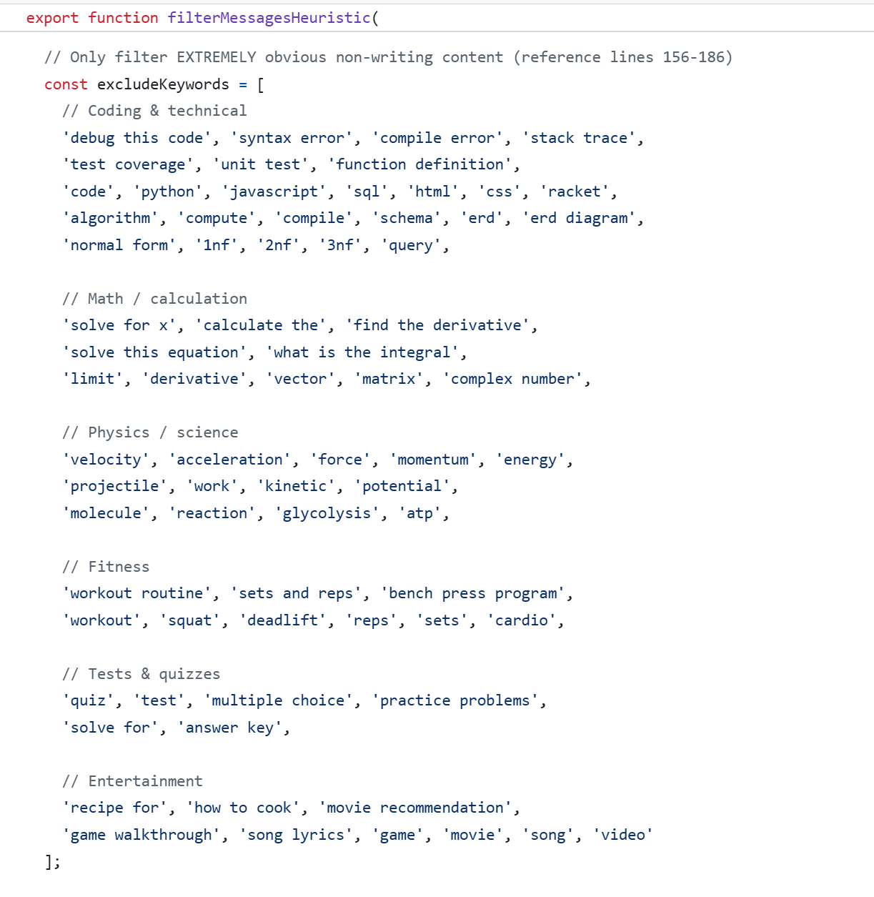
Step 1 - Heuristic Filtering

Slide 9
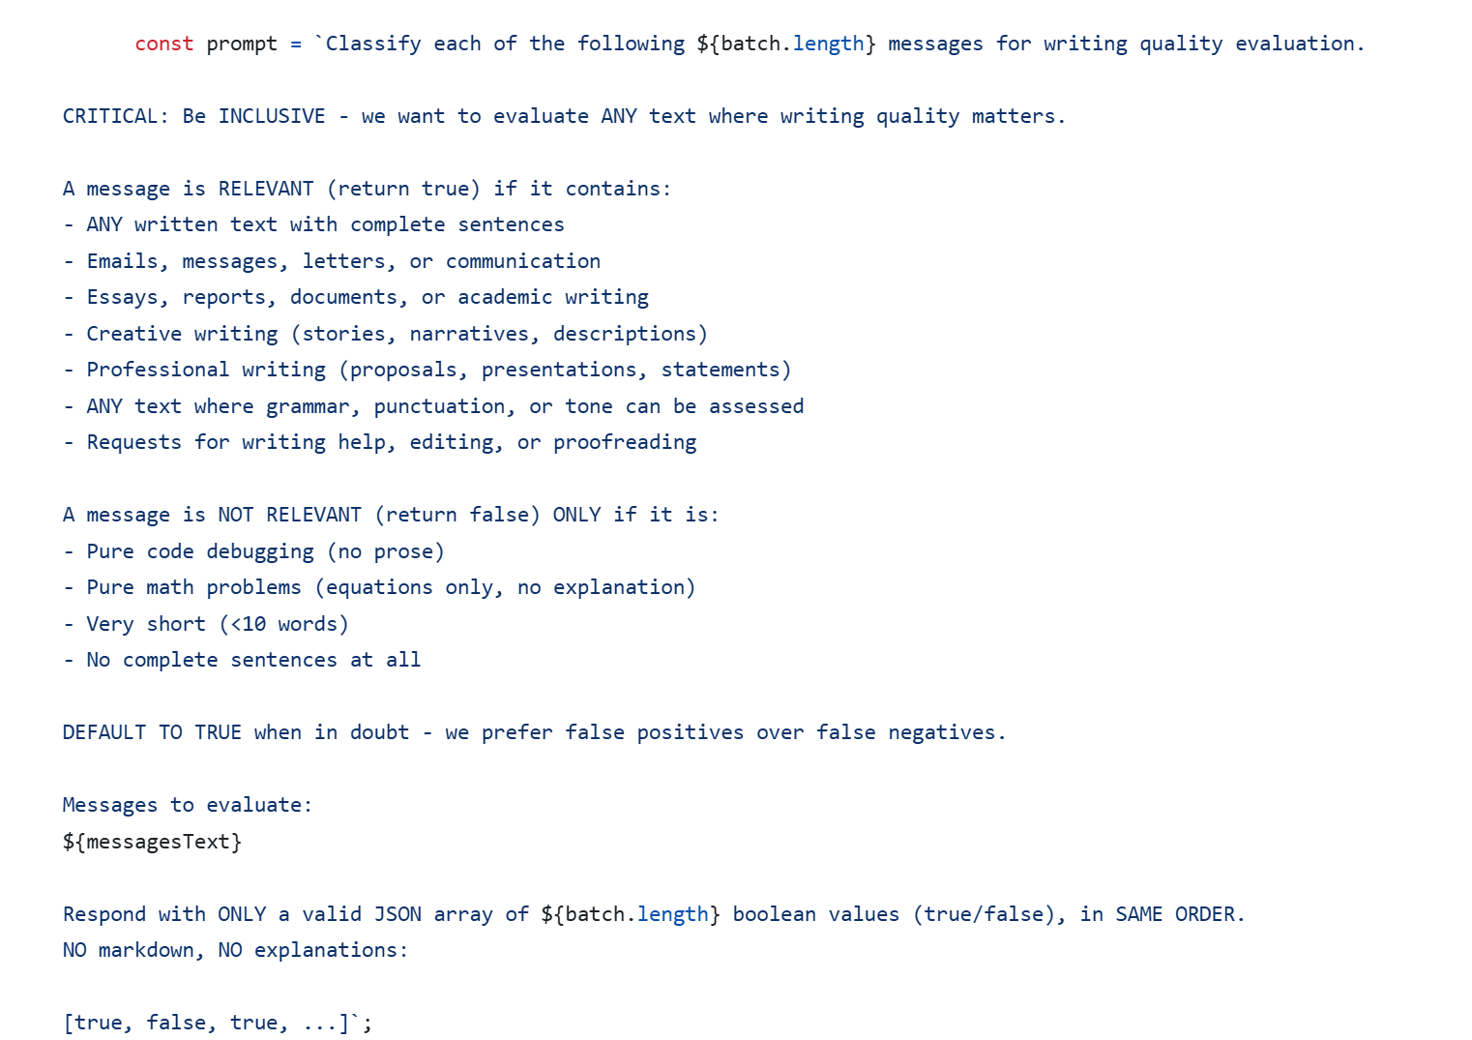
Step 2 - LLM Confirmation

Slide 10
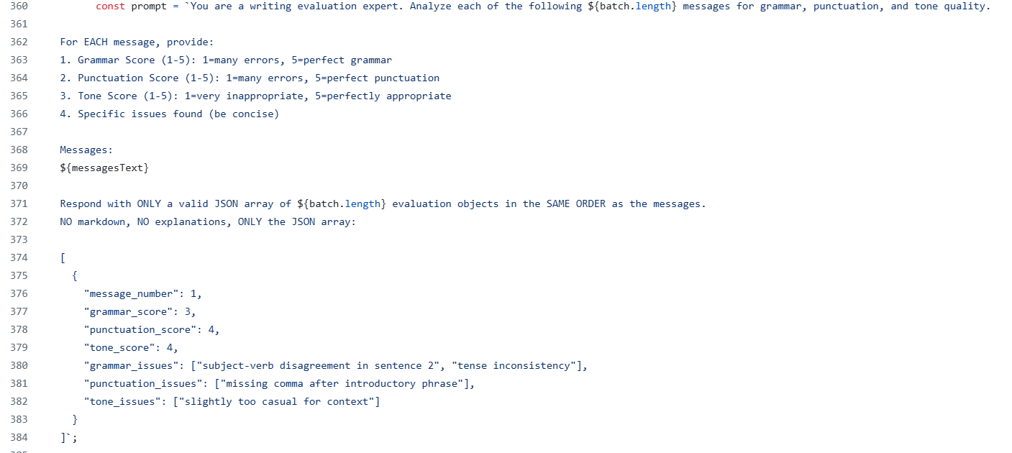
Step 3 - Scoring Each Chat

Slide 11
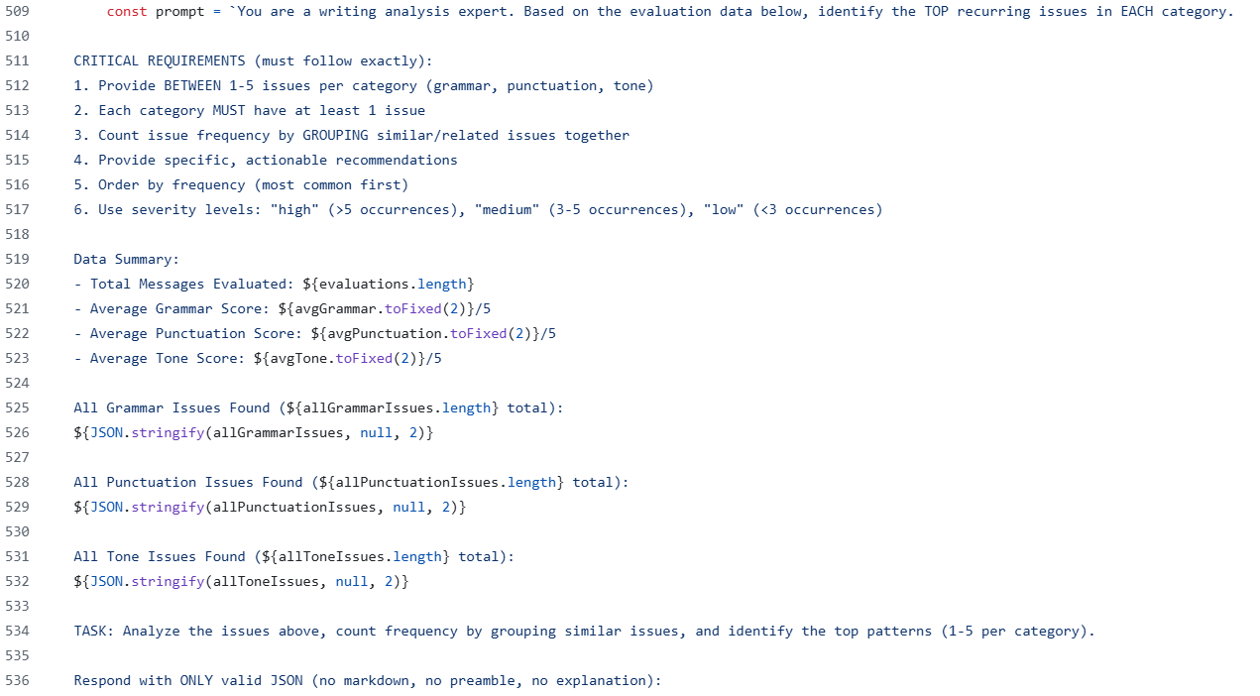
Step 4 - Identifying Recurring Patterns

Slide 12
Why This Approach?
Cost Savings
Batch Process
Single
Pass Pattern Analysis
Truncation Strategy
Step 1 filters 60% of messages instantly without any API calls
Step 2 removes another 30% before expensive detailed evaluation
Only 40% of original messages reach the costly Step 3 scoring phase
Steps 2 & 3 process 10 messages per API call instead of 1
Single prompt evaluates multiple messages simultaneously
Reduces total API calls by 90% compared to individual message evaluation
Step 4 analyzes all evaluations in one API call
Groups and ranks issues without re-reading messages
Avoids expensive per-message pattern detection
Step 2 only sends first 800 characters of each message for confirmation
Full message text only sent in Step 3 after confirmation
Saves ~50% of input tokens during confirmation stage

Slide 13
Data Flow
Raw Chat Data
Extract & Filter (4 stages)
Baseline Analysis (scores + issues)
Generate Practice Plan (targeted questions)
User Practices (3 sessions)
Track Progress (dashboard)
Re-Evaluate (measure real improvement)

Slide 14
Live Demo

Slide 15
Project Goals: Questions Re-answered
Which approach will generate a more robust classification?
We have determined that the LLM API is the most effective classification but the most cost-effective solution would be to take a hybrid approach using multiple methods.
How useful will the Weakness Report be?
The Weakness Report will be very useful given that we are using an extremely accurate model (ChatGPT) and only analyzing actual writing, not casual chat.
What prompts will be the most effective to classify and generate clusters?
Prompts that are more professional and less casual will be the most effective to classify, hence why we’ve coded the model to only accept those kinds of prompts.
Should the weaknesses only be restricted to writing improvement?
For the current iteration, it will be but future iterations will allow for additional weakness classification such as coding or life metrics

Slide 16
Expected Outcomes:
Did We Reach Them?
How meaningful will the classifications be?
Given the accuracy of LLM classification and semantic classification, our hybrid classification approach will be very accurate and thus very meaningful
What happens if a users data does not include any writing data?
The data will simply not be evaluated. It will be filtered out
How will we measure the re-testing once a baseline is achieved?
The baseline will serve as a comparison for analysis.
How will we prevent errors/hallucinations from occurring?
We filtered each message as described in our 4 stage approach

Slide 17
Conclusions
Factoring LLM classification methods with a heuristic filtering is the most efficient and cost-effective course of action
The more messages processed, the longer it will take to process
Can identify up top 5 issues in terms of grammar, tone, and punctuation and create a plan for improvement

Slide 18

Q&A
Any questions? Ask away!
‹#›

Slide 19
Thank you!

